Slide 1

Commodity Plus Carbon (CPC)
Mitigating Climate Change and Reducing Carbon Emissions in Agriculture
Developed by GIC Group

Slide 2
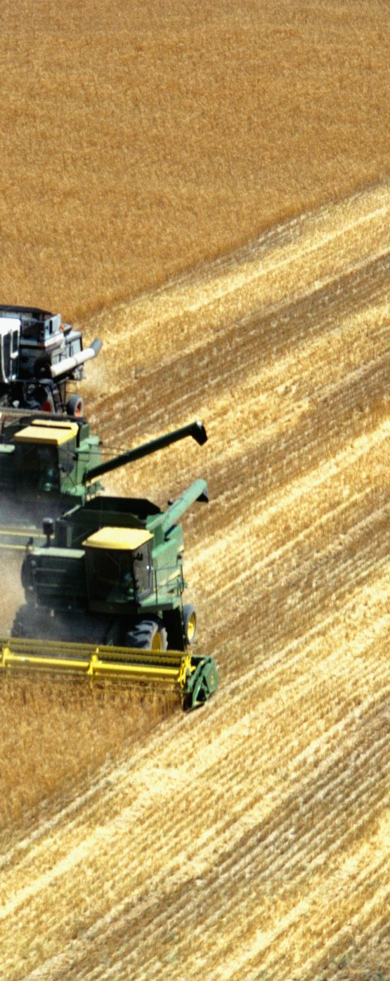
Issues of Today and Goals of Tomorrow
Issues:
  The agricultural sector, which includes the entire value chain and services, accounts for approximately 11% of global GHG Emissions levels.
  GHG ratios (%) attributable to the ag value chain are as high as 31% in livestock & fisheries; 27% in crop production; 24% in land use; and 18% in supply chains.
  Soil degradation is a significant cause of these dramatic changes and serves to compound the problem of reducing carbon emissions levels and meeting the challenge of achieving sustainability.
  COVID-19 and the global economic slowdown have resulted in revenue losses for the entire agriculture/ agribusiness value chain.
Goals:
  Good agricultural practices
  Reaching Paris Agreement/COP reduction targets
  Developing “green” sources of revenue into crop production and the agricultural value chain
  Mitigating risk for climate change

Slide 3

Market Opportunity
CPC (commodity plus carbon) is a climate risk mitigation system based on new futures contracts for crops and food and feed products.
CPC contracts maximize reduction & sequestration benefits of new technologies and good agricultural practices​.
Risk mitigation: Creates a new hedging instrument for strategic, high volume commodities in futures markets.​
New revenue potential from input cost reductions and incentivized good agricultural practices.​

Slide 4
Solution
The CPC strategy is to use futures contracts to incentivize good agricultural practices. It is a market approach to reducing carbon emission levels and to sustainable agriculture.
Ecosystem Market Management
GAP (good agricultural practices)
Incentivized Sustainability Practices
Climate Risk Mitigation

Slide 5
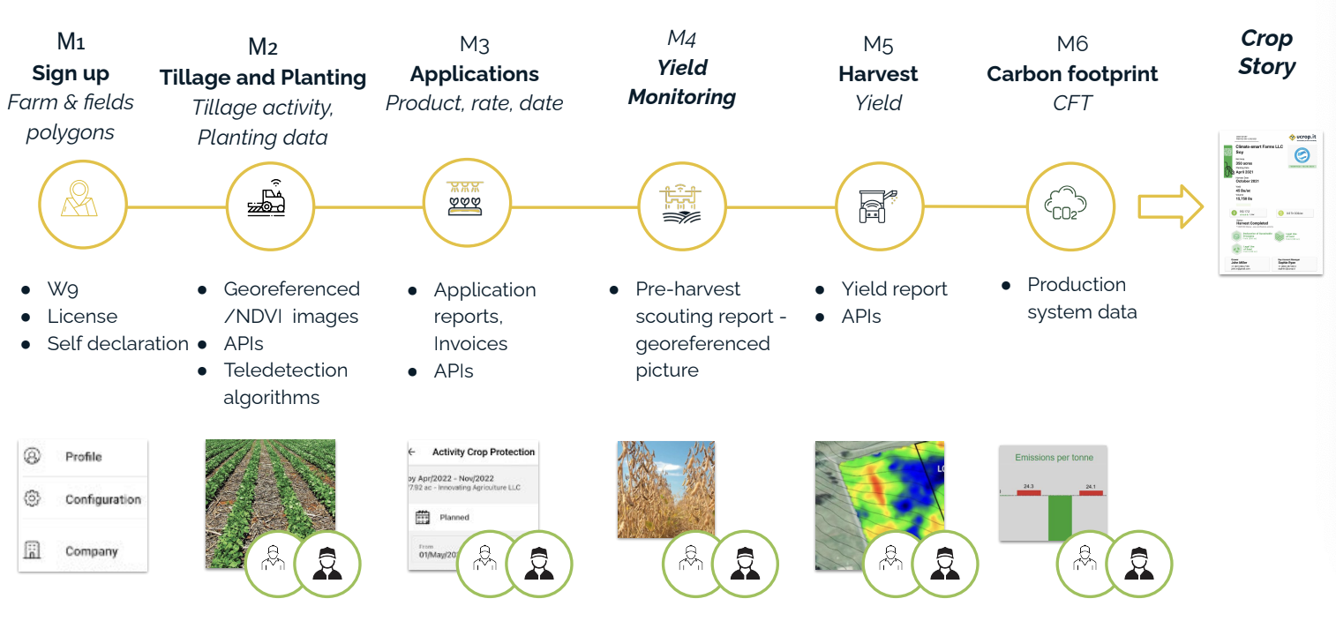
Building the Crop Story
Milestones
Evidence*

Slide 6
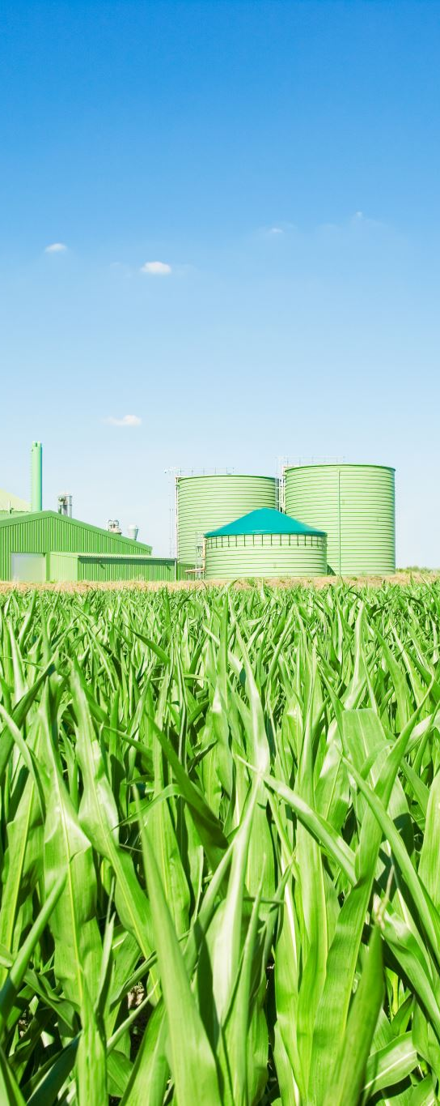
CPC Competition & Pitfalls
“Green” bonds/ securities or ESG impact investment funds/ private equity financing (Environmental/Social and Corporate Governance)
  Lack of transparency (insufficient reporting standards)
  No guaranteed use of proceeds
Private sector carbon credit payment/trading programs
  Companies continue to emit same GHG levels, offset by purchasing credits – greenwashing
Direct farm payment initiatives for carbon reduction
  Lack of market incentive hinders both scaling and private sector emission reduction capabilities

Slide 7
Differentiation of CPC
Diverse databases and data dumps from sensory detection sources
Reputable source for verification: ucrop
Blockchain Technology
Mass Balance delivery certification system
Crop and product contract roll-outs: Corn, Soybeans, Sorghum, Ethanol, Canola, SRW wheat, HRW wheat, Lean hog, Live cattle, Feeder cattle, Cocoa, Cannabis and Hemp
Market sensitive mitigation instrument
Horizontal and vertical revenue generation

Slide 8

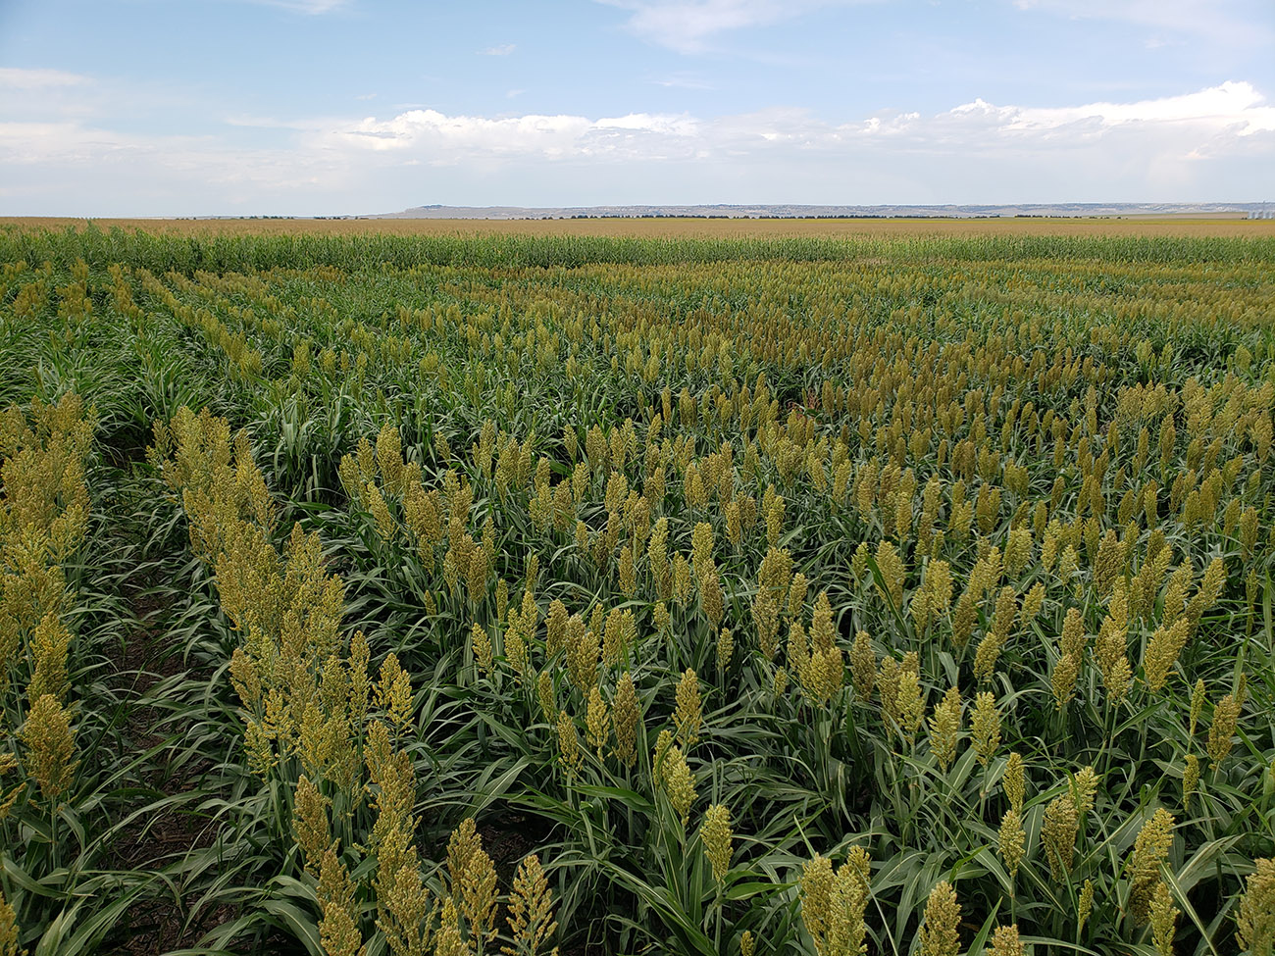
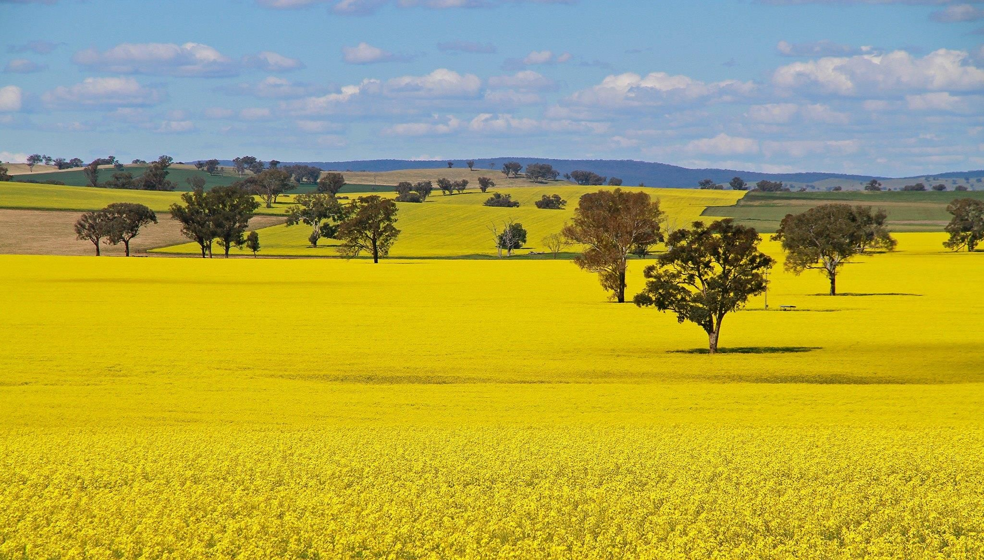
Investment Proposal for CPC
Individual crops that either feature GHG reducing traits or are produced through carbon reduction and sequestration technologies and practices
Low-cost bundling (25%/75%) of the value of a producer’s carbon reduction practices with the value of the physical commodity
ROI based on negotiated royalties on CPC contract listed on Exchange(s)

Slide 9
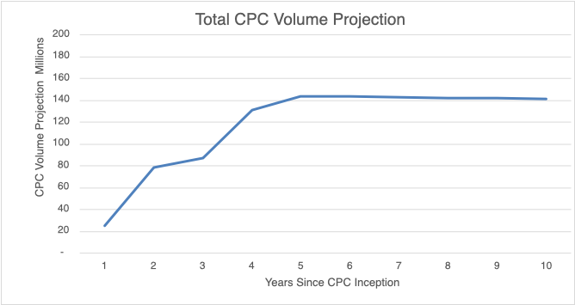
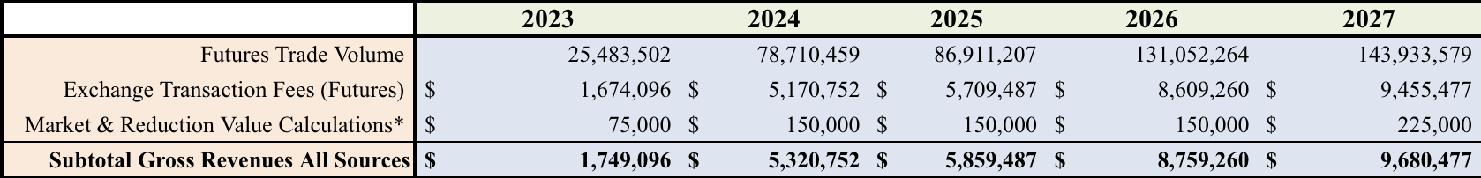
Revenue Model of CPC
Revenue from Exchange Transaction Fees (Futures)
Three CPC contract roll-outs in Year 1, three roll-outs in Year 2, three in Year 3, two in Year 4 and two in Year 5
10-year trading volumes projected using average 5-year growth rates

Slide 10
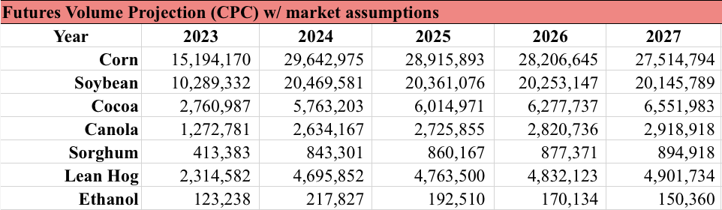
5-Year Financial Projection
Pilot commodities for CPC contract:
Corn, Soybean and Cocoa – Year 1
SRW Wheat, HRW Wheat and Sorghum – Year 2
Canola, Ethanol and Lean Hog – Year 3
Live Cattle and Feeder Cattle – Year 4
Cannabis and Hemp – Year 5
5-year IRR: 52.35%
5-year NPV: USD $13,019,586
10-year NPV: USD $33,110,157
5-year EBITDA:USD $25,120,343

Slide 11
Milestones
Objectives
Use of futures contracts to mitigate climate change risk through good agricultural practices. Crop cultivation accounts for 49.2% of total GHG emissions in agriculture.
Create additional revenue for farming and agribusiness sectors.
Roadmap
Phase I:
  Data collection
  Data verification, authorization under VERRA registry protocol
Phase II:
  Establish OTC transactions
  Initiate negotiations for Exchange listings
Phase III:
  MMRV (Measurement, Monitoring, Reporting, and Verification) of the impacts of listed CPC contracts.

Slide 12
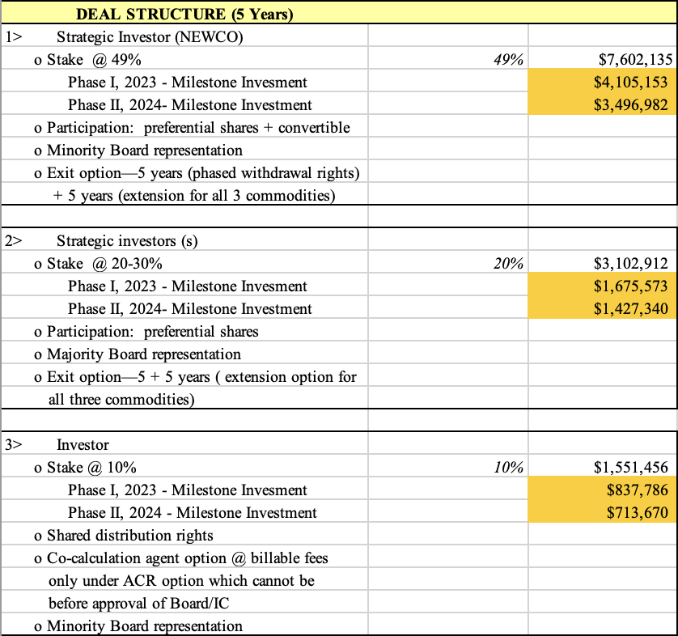
5-Year
Deal Structure

Slide 13
Investment Strategy
Patent carbon reduction measurement methodologies
Secures the intrinsic value of CPC as a proprietary trading instrument
Patent to cover as many steps, and variants, as possible in independent and dependent claims so as to cover the application for diverse mix of CPC contracts
Multiple Exchanges and OTC electronic platforms (CPC “hosts”)
Negotiating contracts for the listing of an array of CPCs
Launch sequence for CPC listings
Beginning in 2021, with a maximum of 3 new CPC commodity contract listings per year.
Determinants of asset value
Patent secured methodology
Goodwill valuation from delayed return of R&D funded phase of the product development
Royalty based returns from contract listings
NEWCO Development
Favorable investment terms corresponding to Proof of Concept, Stage 2 (60% completion) financing
Shareholder aggregation rights to cumulative CPC roll-outs
Founder options to continue initial or expanded participation levels under original terms
In case of IPO, conversion rights to preferred stock for any subsequent rounds of capital raising.
www.GICGroup.com ©2023 GIC Group—Confidential

Slide 14
Investment Participation
Stage IV, Proof of Concept: completion of pilot OTC for CPC corn, CME negotiations
Launch CPC project/2023 (CPC Hemp grant with Lincoln U approved)
Deal structure options designed to afford investors maximum leverage
  Low-level of paid-in capital, the threshold for which is determined by the costs to finalize product development and complete product launch
ESTABLISHMENT OF NEWCO/CPC in Year 2023
$15,514,561
IRR | 52.53%
NPV(up to 49%) | $13,015,586
www.GICGroup.com ©2023 GIC Group—Confidential

Slide 15

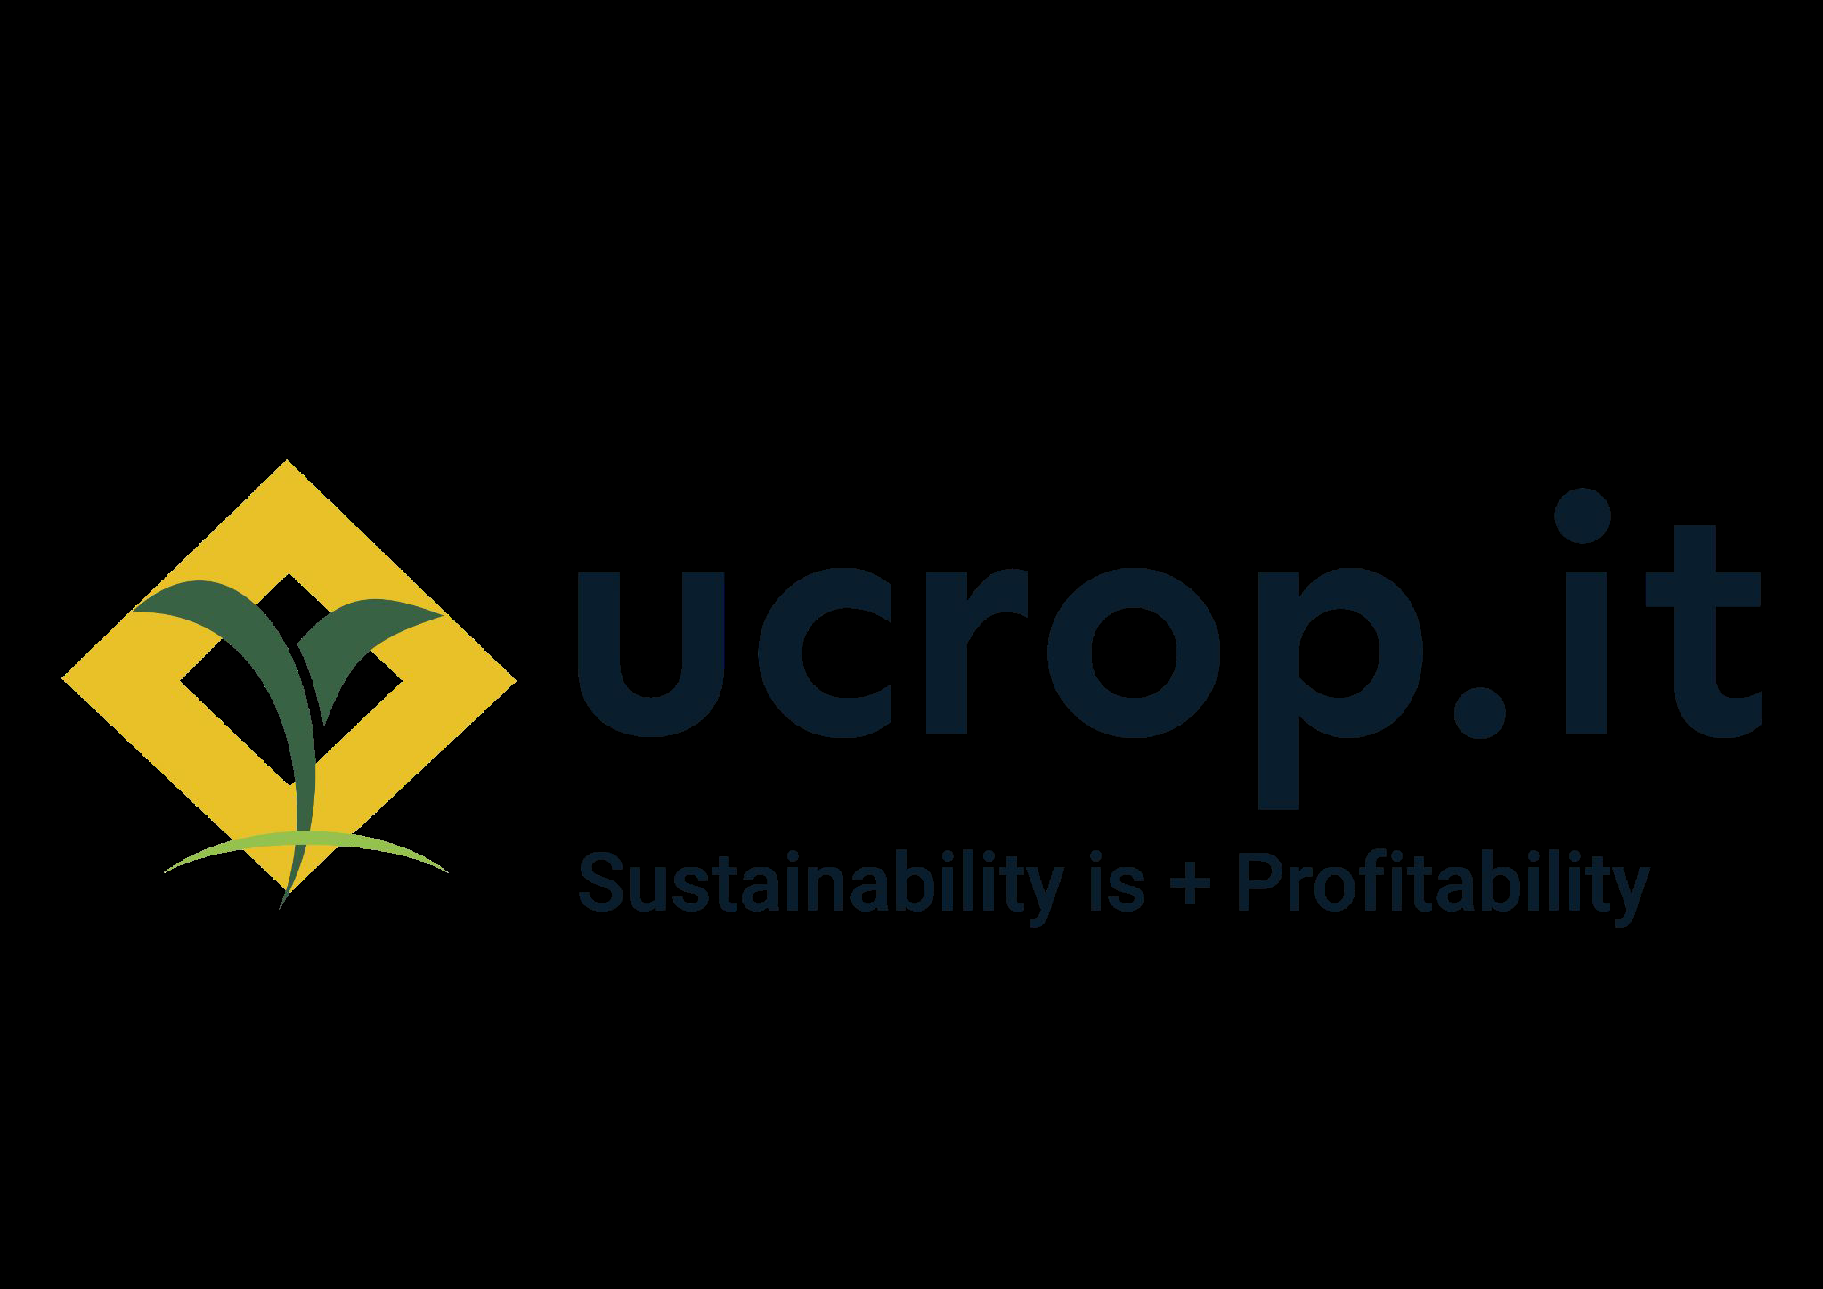
Management/PartnerTeam
Richard Gilmore, GIC Group, President/CEO
Former Special External Advisor to the White House and USAID on Global Food Security
Trustee for Nutrien, Board member-Swiss investment group, and corporate and public sector
Advisor
PhD, International Economics and Trade, Fulbright and Rockefeller Foundation fellowships
ucrop, (Partner for Data Verification)
CPC data authentication and verification responsibilities
Nathan DiNiro, CEO and Founder, Full Granklestein Ventures, Inc. (Partner/Blockchain Specialist)
Blockchain securitization of CPC data.
Steffen Mueller, Principal Economist, Bioenergy, University of Illinois/Chicago (Partner/Mass Balance Specialist)
Mass balance certification for CPC commodity deliveries
www.GICGroup.com ©2023 GIC Group—Confidential

