Slide 1
Commodity Plus Carbon (CPC) Futures Contract Program

Slide 2
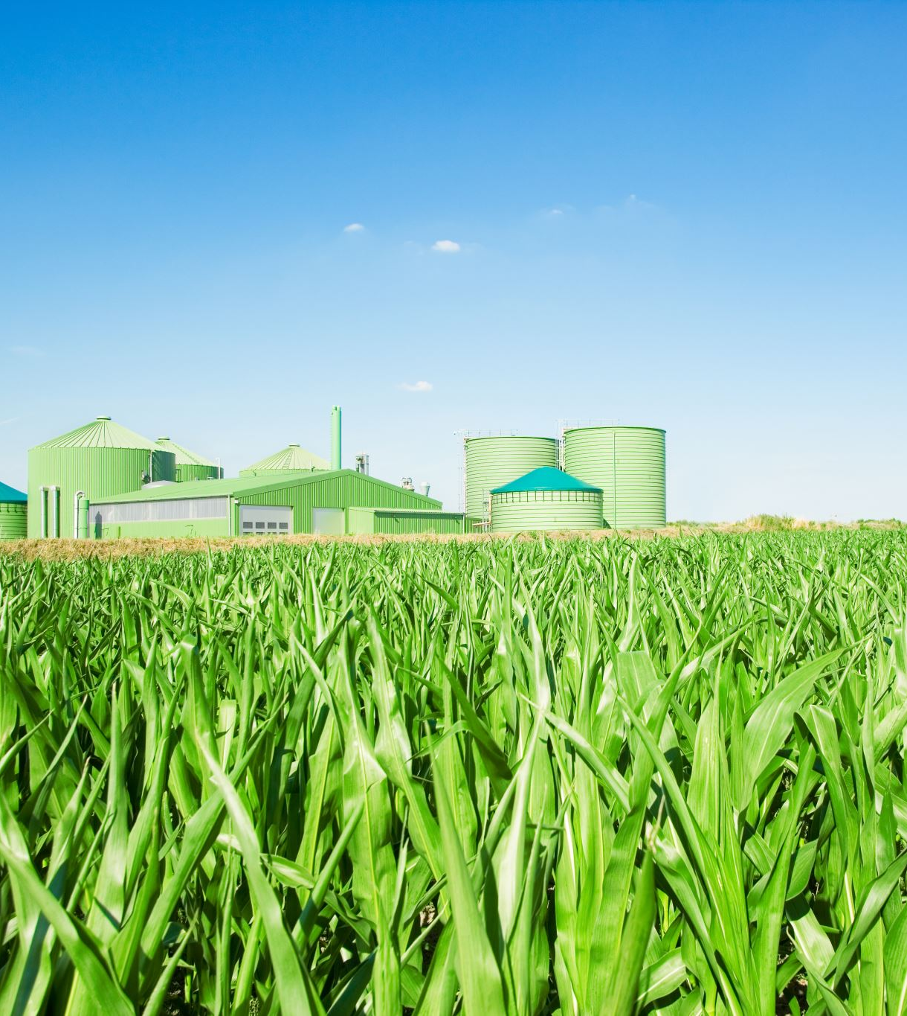
CPC Solution
CPC futures contracts generate ag premium prices from carbon emissions reductions
Each CPC crop or ag product futures contract combines:
75% – ag commodity price
25% – carbon price valuation based on level of carbon reduction below benchmark
CPC contracts incentivize GAP (good agricultural practices), create hedging opportunities, and Scopes 1, 2, and 3 footprint values for buyers.
Can be based off single load, entire field, or segmented field growth

Slide 3
Process
Emission reduction data (Satellite, Fieldview, TopCon, Other)
Authentication / verification according to Carbon Registry Protocol
Emissions reductions measured against pre-established benchmark
Emissions reductions below benchmark factored into CPC premium
All data is secured via blockchain technology
Data Collection
Verification
Evaluation
Pricing
Protection

Slide 4
Six Year Stress Test – CPC spreads over cash/basis prices
Scenario 1: Current Carbon Credit (CC) Prices
CPC Corn: +238%, CME Corn: +102%
Scenario 2: Lower CC Prices (25% annual decline)
CPC Corn: +115%, CME Corn: +39%
Scenario 3: Stable CC Prices (2% annual growth)
CPC Corn: +164%, CME Corn: +71%
Scenario 4: Higher CC Prices (25% annual growth)
CPC Corn: +213%, CME Corn: +103%

Slide 5
Existing Solutions vs
CPC Carbon Inset Strategy
“Green” bonds/securities or ESG impact funds / private equity financing
Private sector carbon credit allowances/ trading programs
Direct farm payments for carbon emissions reduction under long-term contracts
CPC allows direct revenue generation from built-in carbon emission reduction premiums
First- adapter advantages
Minimal transaction cost to growers and buyers
Limited liability and flexible participation
80% Favorable Grower polling response rate

Slide 6
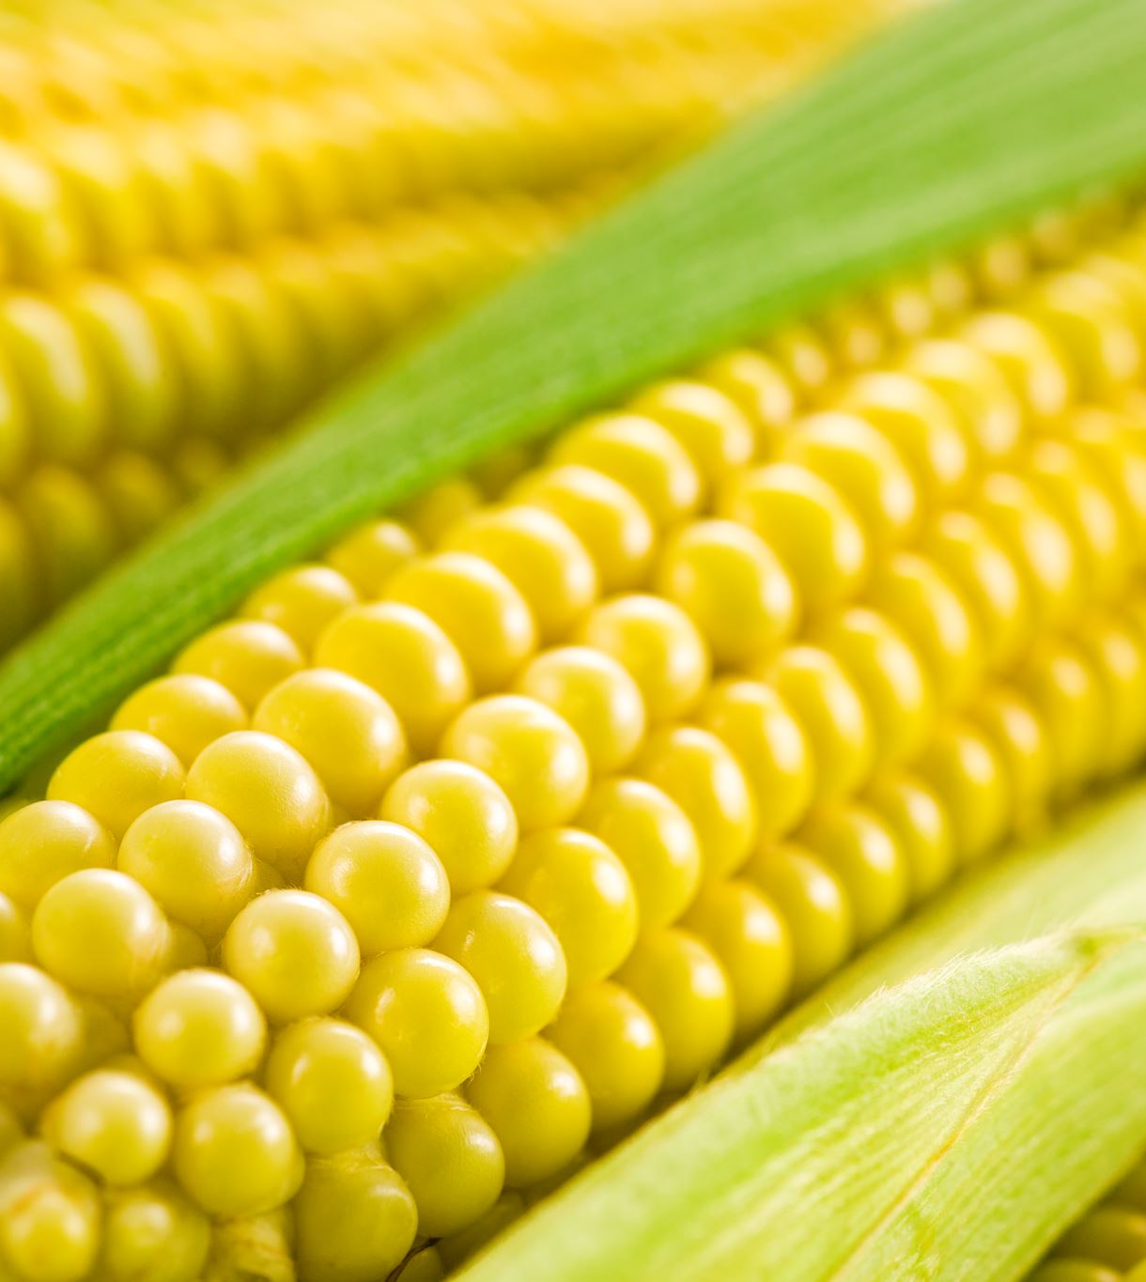
CPC Supply-Side Benefits
Grower: premium cash/basis on crops
Insurer: Maximize Scope 1, 2, and 3 benefits with insurance on CPC-eligible crops
Elevator: Scope 1, 2, and 3 direct and indirect premiums in re-sale of CPC deliveries to buyers, premium hedging
Ethanol/CPG Processors: Scope and lower carbon footprint evaluations

Slide 7
Buyer Benefits
Scope 1, 2, 3 benefits imputed discounts to buyers
Mass Balance sourcing methodology certifying CPC crop deliveries
Scope benefits
Enables lower carbon footprint branding
Importer verification for foreign national/ regional carbon reduction standards

Slide 8
FAQ
How are carbon emissions tracked?
Data authentication and protocol verification procedures
Blockchain use enables the tracking of all relevant crop attributes from farm to fork
Mass balance certification for sourcing CPC and co-mingled corn/soybeans/other bull commodities
The industry is slow to adapt…why be ahead of the curve?
Early adopters will be able to capture low carbon credit prices before they increase
Demand for climate friendly grain exists – largely unaddressed
Mitigate erosion of export market share by failure to meet foreign buyer carbon reduction requirements

